Slide 1
Chocolate and Cocoa Beans
Fairtrade and Rainforest Alliance

Slide 2


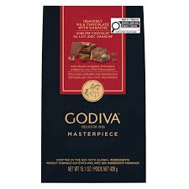
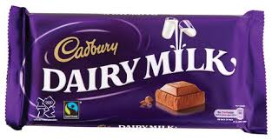
Free vs Fair trade, what’s the difference ?
Jack
You’ve probably heard every so often that chocolate that you are consuming are made with Free trade cacao beans rather than Fair trade cacao beans, but what’s the real difference?
Free Trade (Mass-Market)
$2.25 / bar
Fair Trade Certified
$5.50 / bar
Price Premium: +$3.25 (144.4%)
Fair trade products such as Fair trade cacaos, coffee beans and cottons etc. are slightly more expensive than regular free traded products in margin of about 2 ~ 3 dollars to equally and rightfully support workers who produces raw ingredients as such.

Slide 3
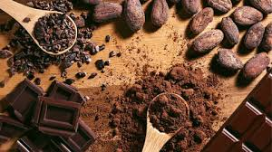
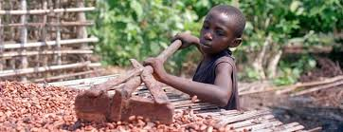
Why buy ethically sourced cocoa?
Stop child slavery - buy fair trade cocoa
Companies like Camino use ethical priming by telling a story and using photos of their farmers, and also marketing their chocolate as “healthy” compared to other chocolate bars
People want to feel like they are making a difference so if the packaging makes it seem like they are “saving children” this means consumer are more likely to pay the extra few bucks.

Slide 4
Importance of buying Fair trade products
Fair payment and living wage:
The fair trade organizations pays proper wage that is guaranteed based line above the volatile low market prices in order to cover basic human needs.
No forced or child labor:
The fair trade organizations ensures and surveillance to strictly prohibit any forms of child labor and forced labors.
Enviornmental sustainabilty:
The fair trade organizations replaces the harmful chemical sprays with organic composting eco friendly ones to protect environment and farmer’s health.

Slide 5
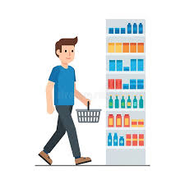
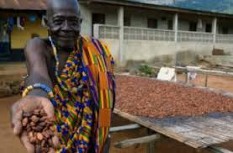
Narrative and pitch
When Mr. Waugh walks into a grocery store and sees a chocolate bar with a picture of a farmer on it and sees the story about helping farmers in africa he will feel compelled to buy fair trade to provide a better life for these farmers and their communities.

